Slide 1
Focal Loss for Dense Object Detection (RetinaNet)
HTsung-Yi Lin Priya Goyal Ross Girshick Kaiming He Piotr Dollar
Facebook AI Research (FAIR)
rayjang111@gmail.com
HyunSukJang

Slide 2
CONTENTS
01
02
03
04
Introduction
Focal Loss
Architecture
Evaluation

Slide 3
01
Introduction
.

Slide 4
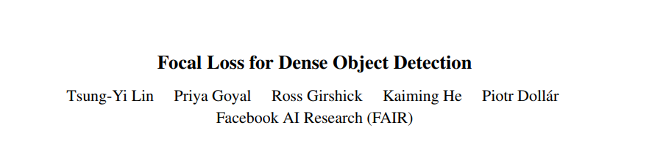
01.
Introduction
Code is at: https://github.com/facebookresearch/Detectron
Submitted on 7 Aug 2017

Slide 5
01.
Introduction
One Stage Detectors vs Two Stage Detectors
2 Stage Detectors:
RCNN, Fast RCNN , Faster RCNN, Mask RCNN
1 Stage Detectors:
Yolo, SSD
vs
Accuarcy
Speed

Slide 6
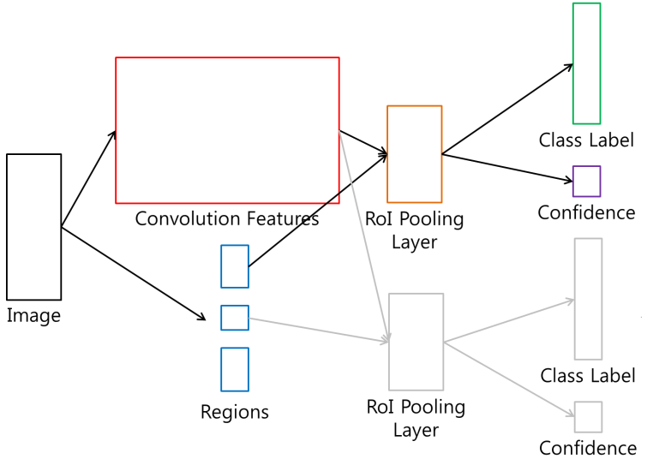
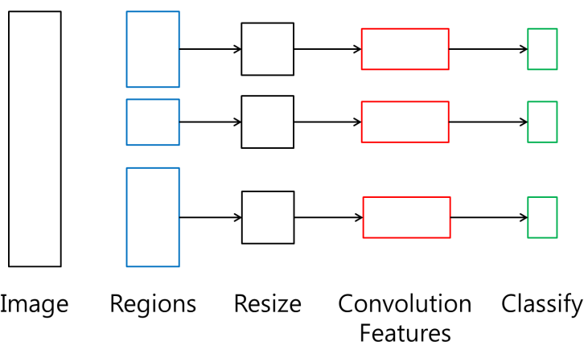
01.
Introduction
What Makes this difference?
One Stage Detectors
R-CNN
Fast R-CNN

Slide 7
01.
Introduction
Faster R-CNN
Fast R-CNN
BB Classification
Image
Fully Convolutional Features
Bounding Box Regression
7

Slide 8
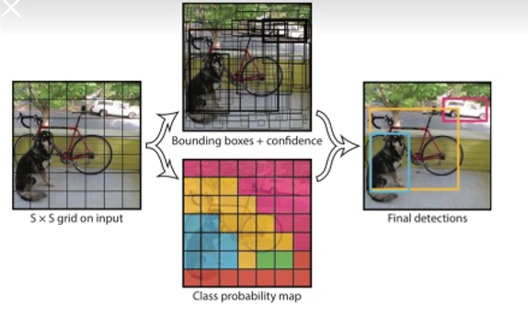
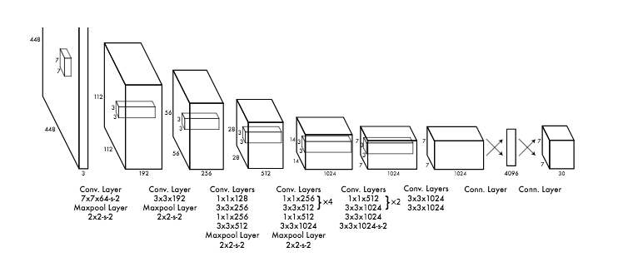
01.
Introduction
Two stage Detectors:
YOLO

Slide 9
01.
Introduction
The main Difference of 1-stage Detectors vs 2-stage Detectors is
Region Proposal
Without Region Proposals, 1-stage detectors make much larger set of candidate object locations.
This makes 1-stage detector’s training procedure still dominated by easily classified background examples.

Slide 10
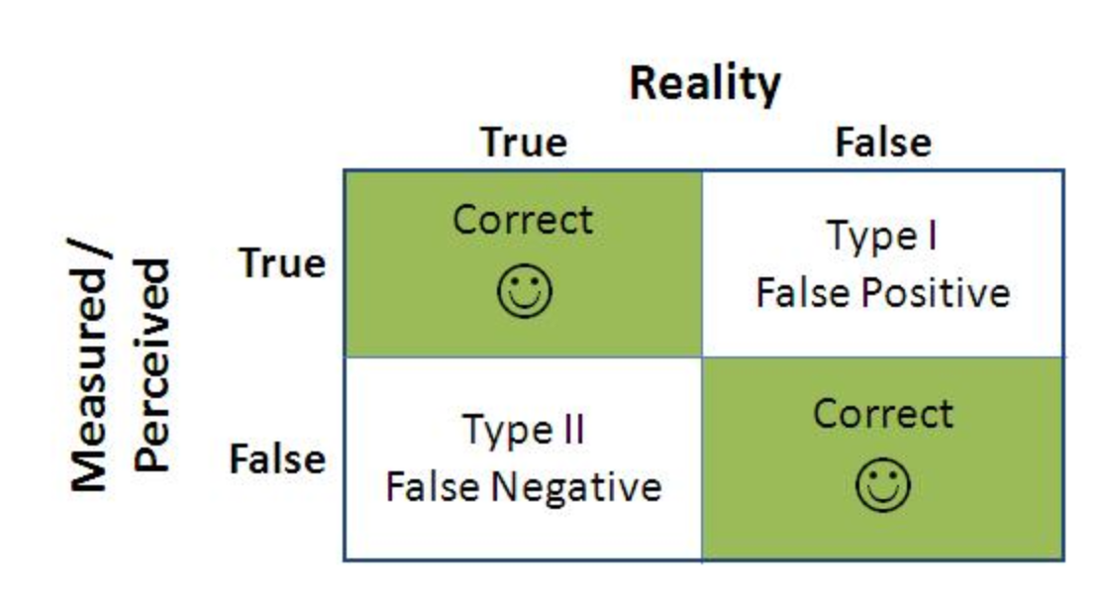
01.
Introduction
Hard Positive(Object)
What is the problem of imbalanced Data??
Easy Negative
(Background)

Slide 11
01.
Introduction
Without any correction, 1stage detectors tend to make less False Positive Decisions.
But avoiding False Positive Decisions lead to make less True Positive Decisions.
RetinaNet suggests to solve this problem by using weighted Loss (Focal Loss)

Slide 12
02
Focal Loss

Slide 13
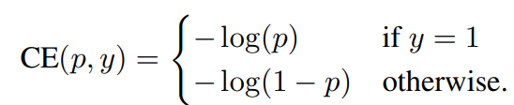
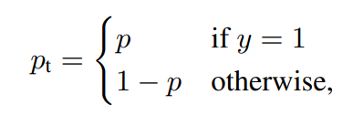
02.
Focal Loss
Cross Entropy Loss
For notational Convenience

Slide 14
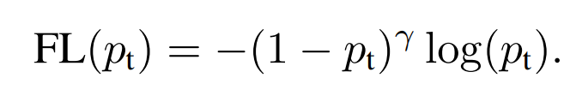
02.
Focal Loss
Focal loss
The loss function is reshaped to down-weight easy examples and thus focus training on hard negatives. A modulating factor (1-pt)^ γ is added to the cross entropy loss where γ is tested from [0,5] in the experiment.

Slide 15
02.
Focal Loss
Two Properties of FL:
1. When an example is misclassified and pt is small, the modulating factor is near 1 and the loss is unaffected. As pt →1, the factor goes to 0 and the loss for well-classified examples is down-weighted.
2. The focusing parameter γ smoothly adjusts the rate at which easy examples are down-weighted. When γ = 0, FL is equivalent to CE. When γ is increased, the effect of the modulating factor is likewise increased. (γ=2 works best in experiment.)

Slide 16
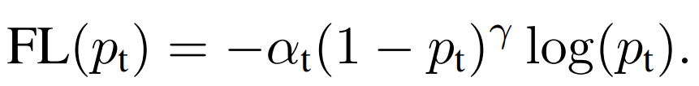
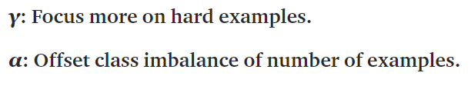
02.
Focal Loss
Alpha-Balanced Variant of FL

Slide 17
02.
Focal Loss
Model Initialization
A prior π is set for the value of p at the start of training, so that the model’s estimated p for examples of the rare class is low, e.g. 0.01, in order to improve the training stability in the case of heavy class imbalance.
It is found that training RetinaNet uses standard CE loss WITHOUT using prior π for initialization leads to network divergence during training and eventually failed.
And results are insensitive to the exact value of π. And π = 0.01 is used for all experiments.

Slide 18
03. Architecture

Slide 19
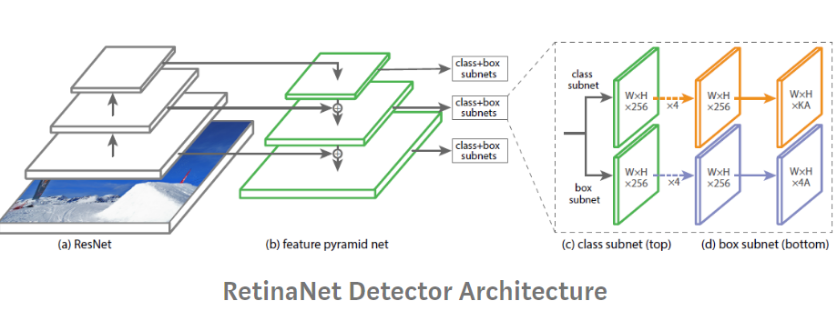
03.
Architecture
Overall Architecture

Slide 20
03.
Architecture
ResNet+FPN Backbone
Resnet is used for deep feature extraction.
FPN is multiscale, semantically strong at all scales, and fast to compute.

Slide 21
03.
Architecture
Anchors
The anchors have the areas of 32² to 512² on pyramid levels from P3 to P7 respectively.
Three aspect ratios {1:2, 1:1, 2:1} are used.
For denser scale coverage, anchors of sizes {2⁰, 2^(1/3), 2^(2/3)} are added at each pyramid level.
In total, 9 anchors per level.

Slide 22
03.
Architecture
Classification Subnet
This classification subnet predicts the probability of object presence at each spatial position for each of the A anchors and K object classes.
The subnet is a FCN which applies four 3×3 conv layers, each with C filters and each followed by ReLU activations, followed by a 3×3 conv layer with KA filters. (K classes, A=9 anchors, and C = 256 filters)

Slide 23
03.
Architecture
Box Regression Subnet
This subnet is a FCN to each pyramid level for the purpose of regressing the offset from each anchor box to a nearby ground-truth object, if one exists.
It is identical to the classification subnet except that it terminates in 4A linear outputs per spatial location.
It is a class-agnostic bounding box regressor which uses fewer parameters, which is found to be equally effective.

Slide 24
04
Evaluation
.

Slide 25
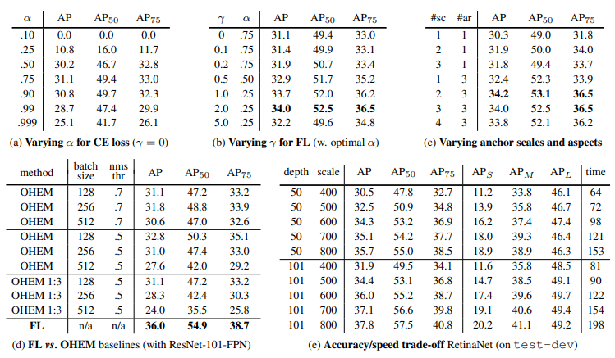
04.
Evaluation

Slide 26
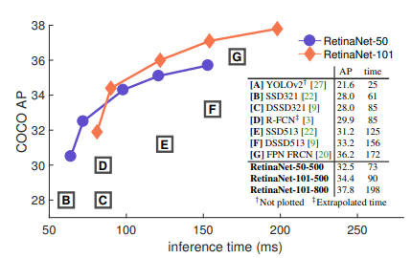
04.
Evaluation

Slide 27
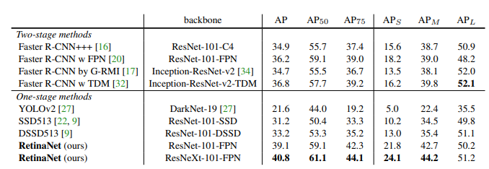
04.
Evaluation

Slide 28
Thank you

